Slide 1
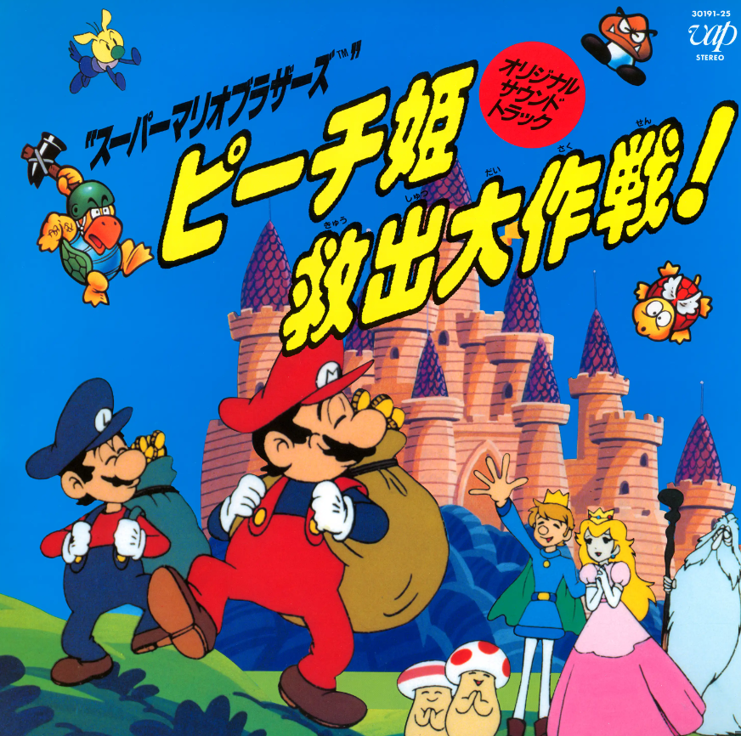
Team Yellow
Super Mario Bro FC Level 1-1 & Boss fight

Slide 2
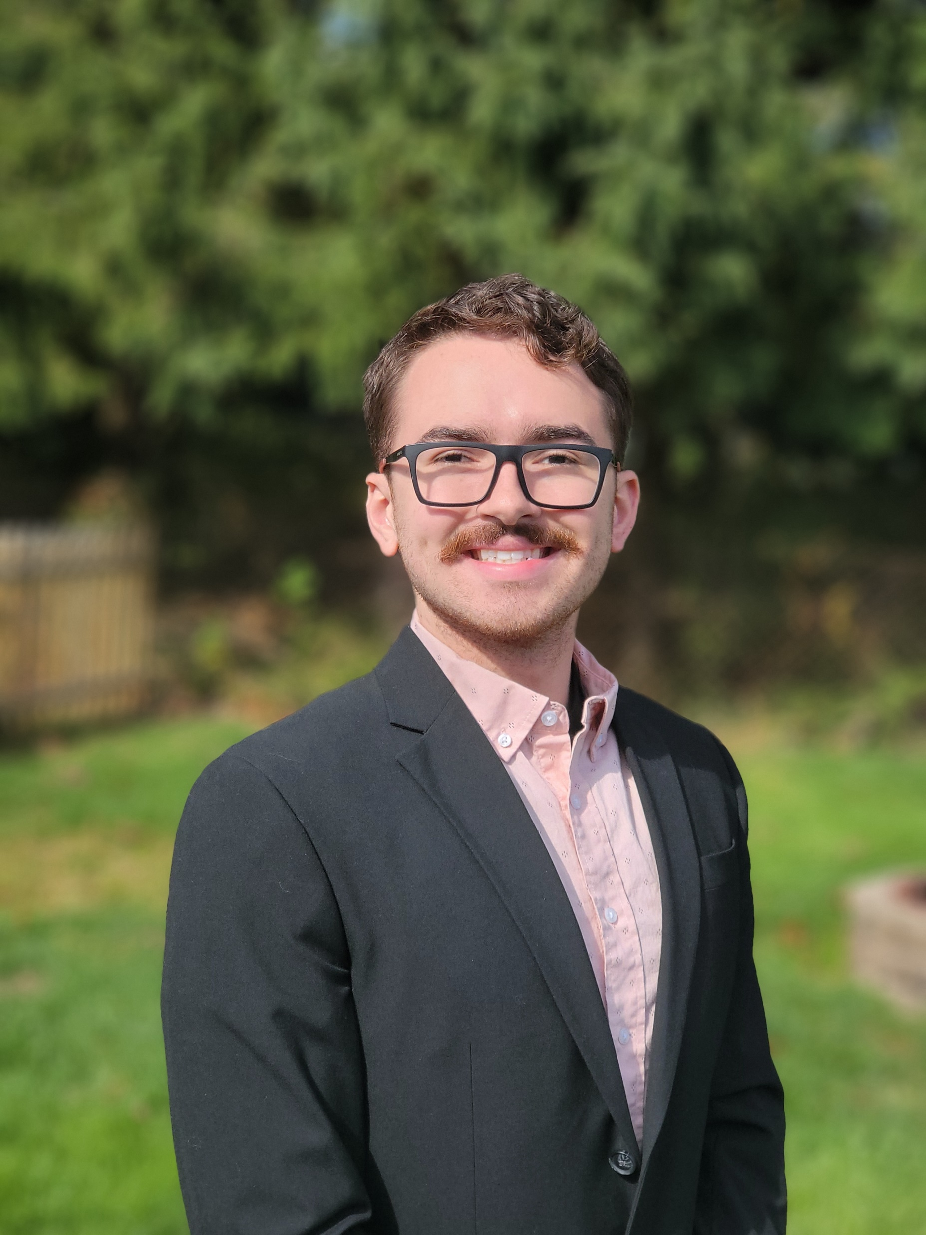
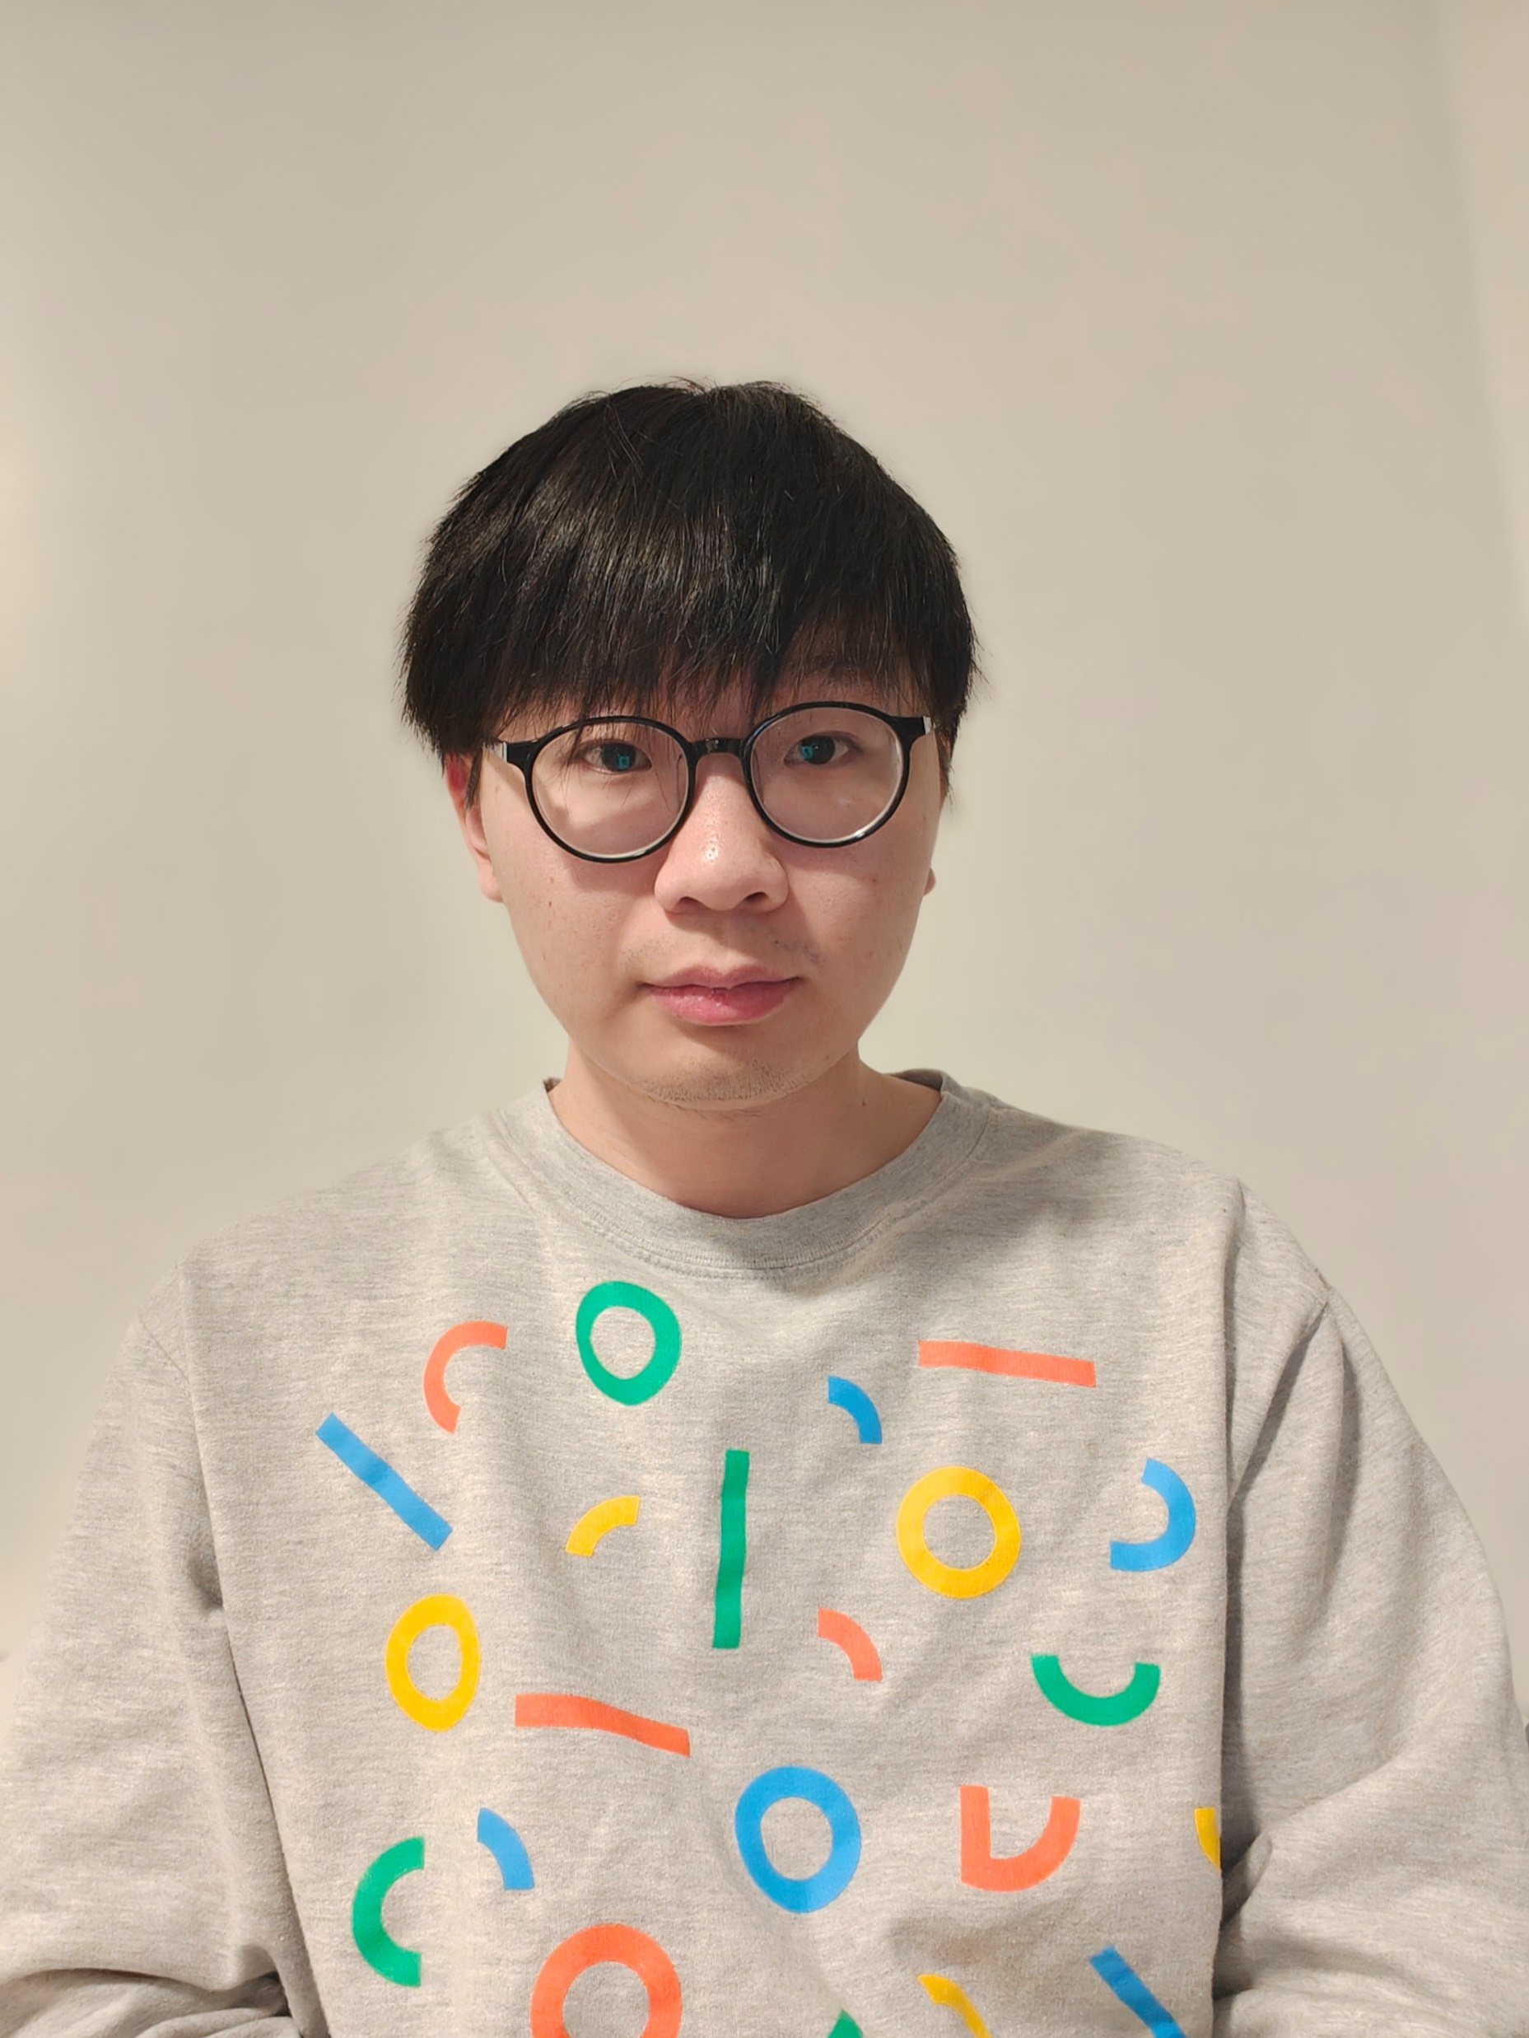
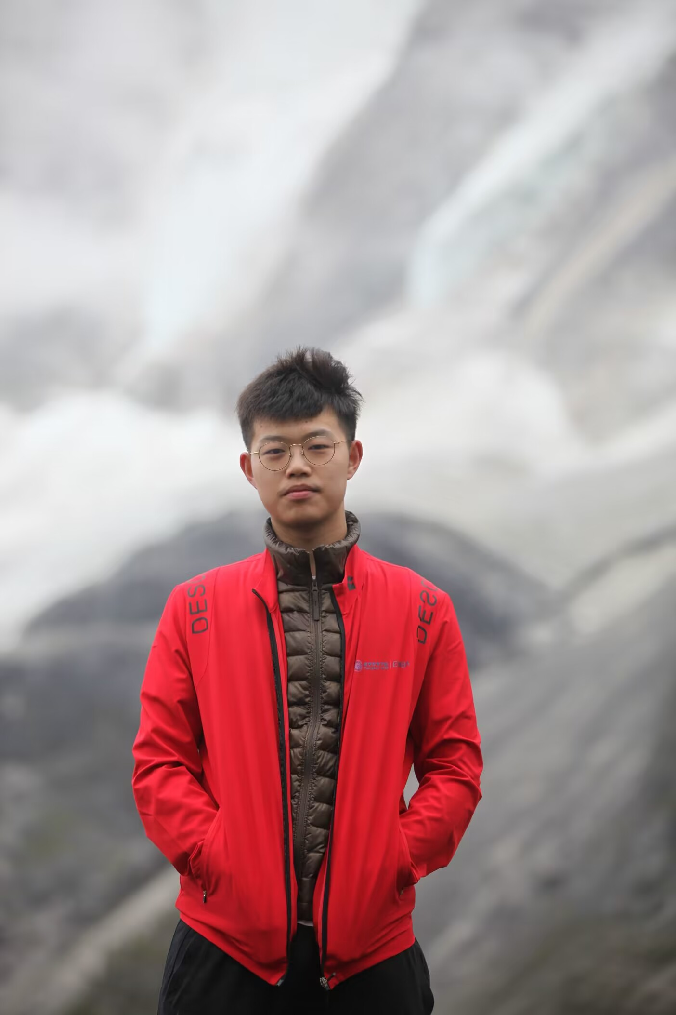
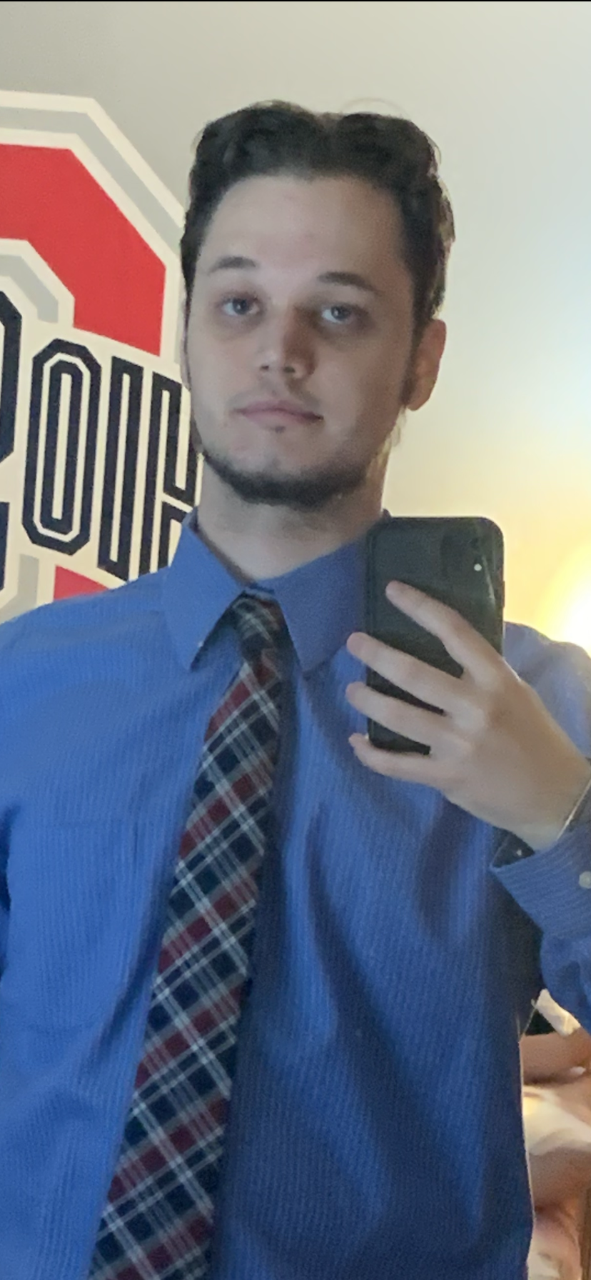
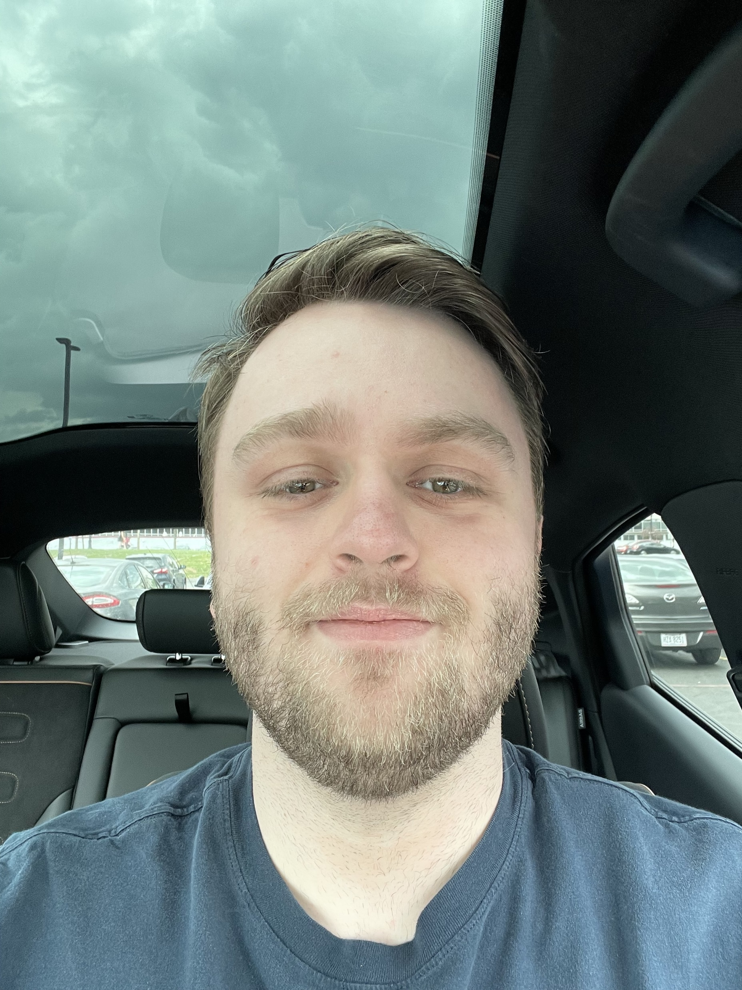
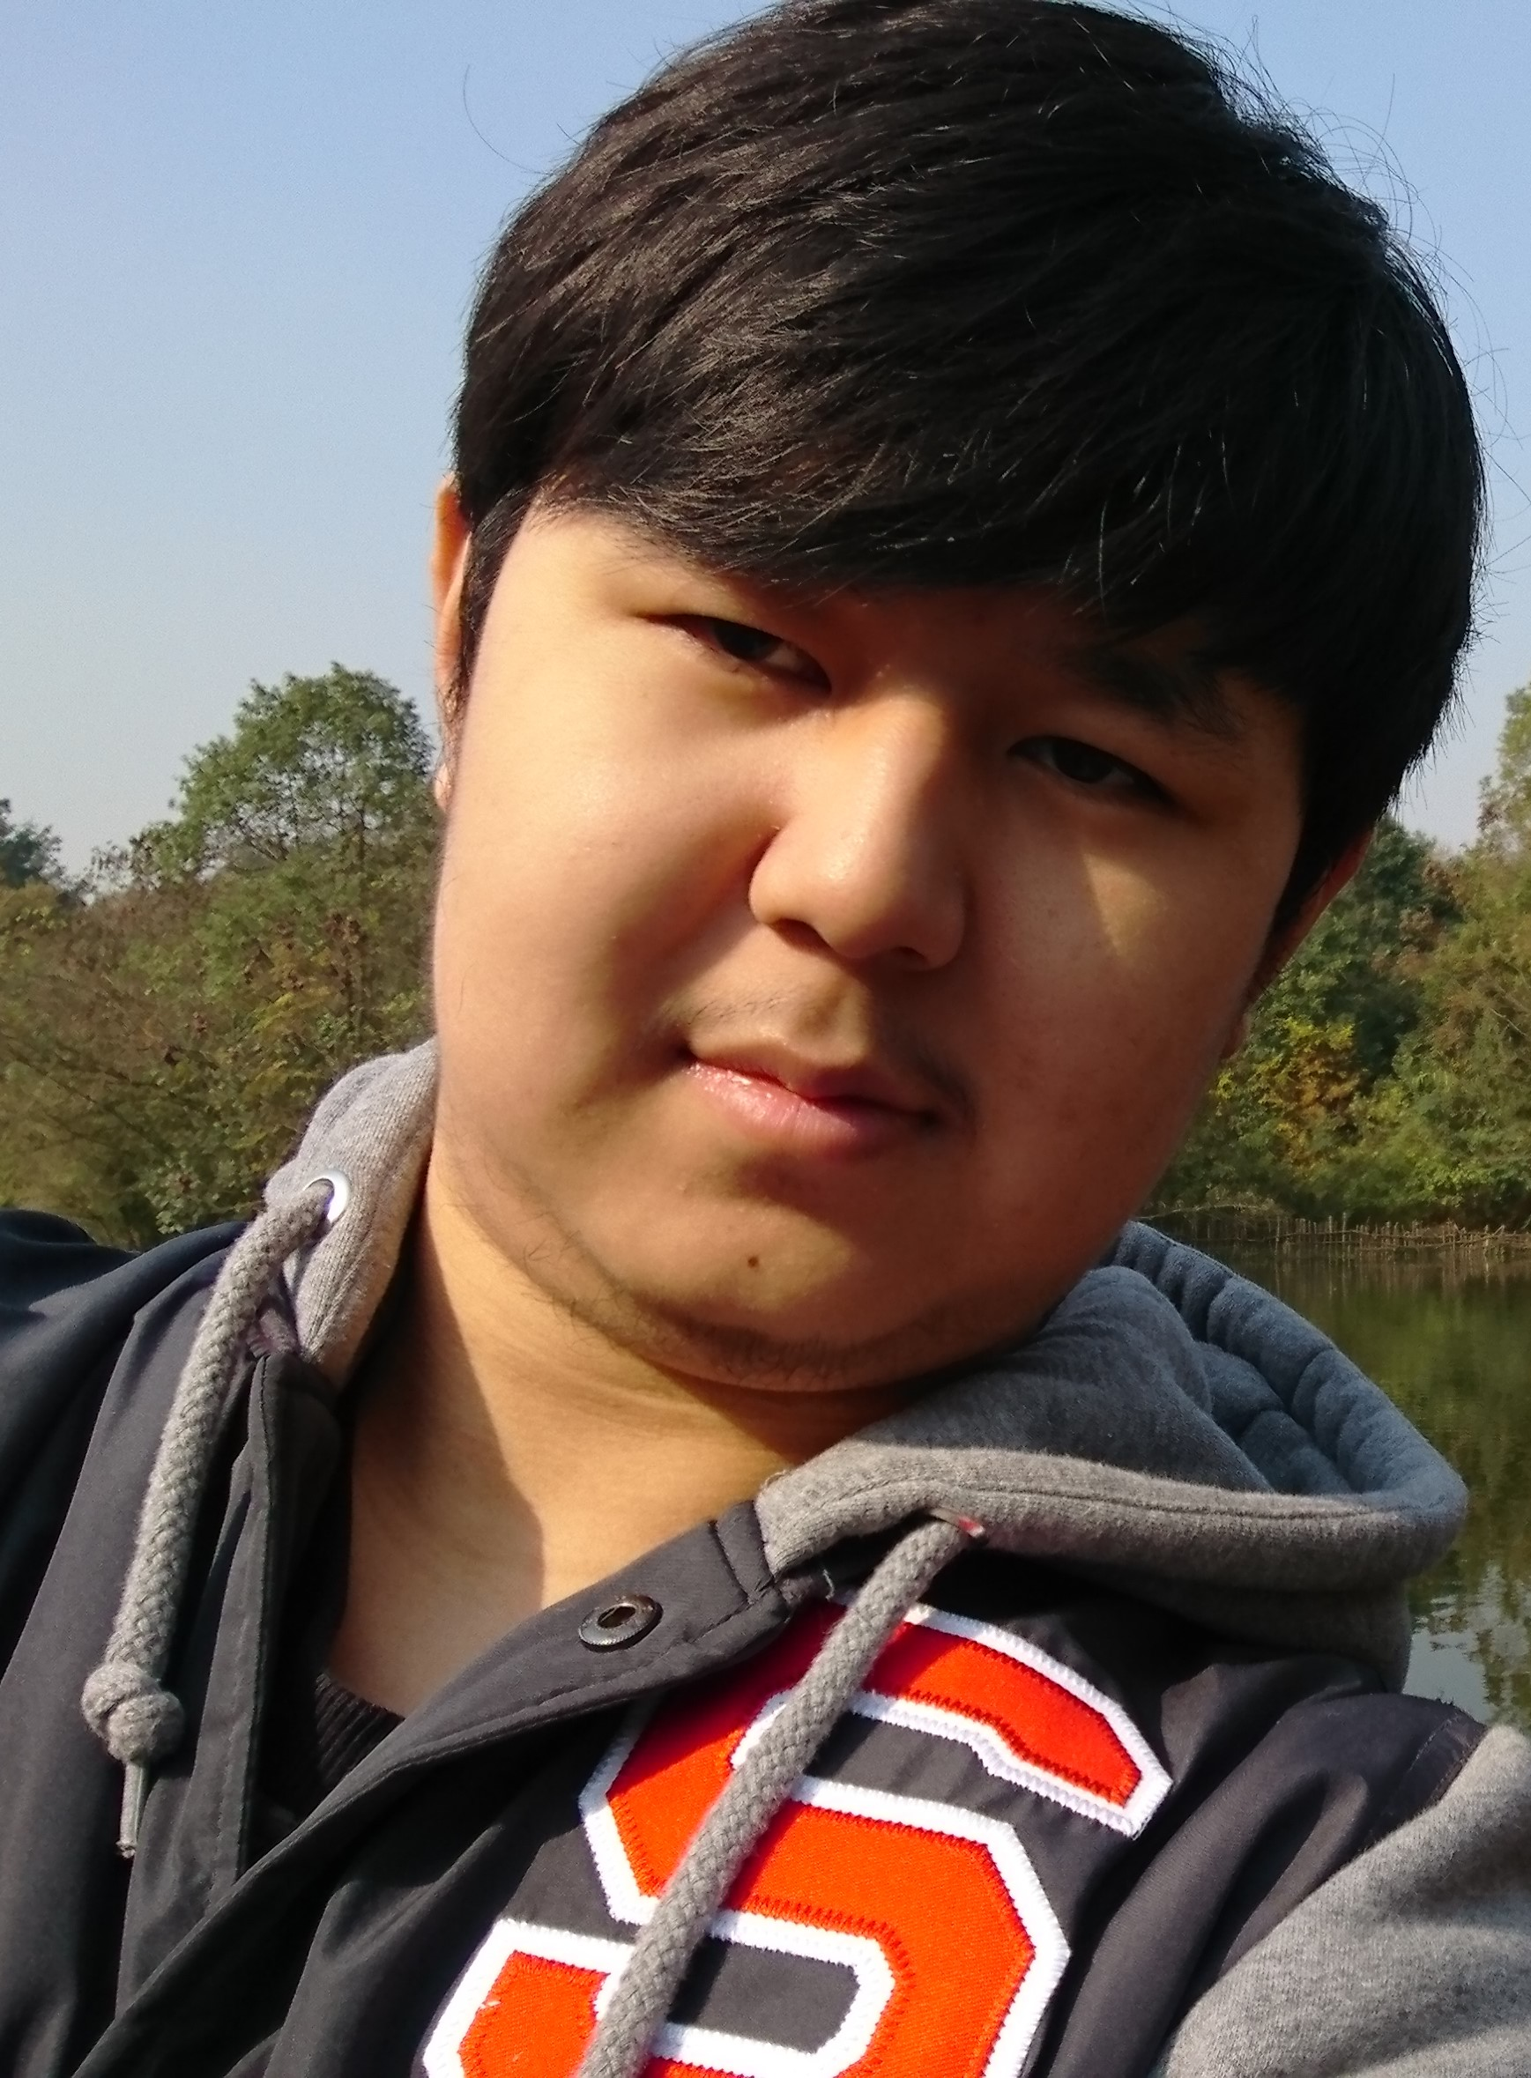
Team Members
Yao Lu
Zhuozi Xie
Kyle Kauffman
Seth Welch
Adam Cote
Shuangchen Zhou

Slide 3

Sprint Features
Second level after 1-1, a boss level
New types of hazards, fireballs from the lava, and blocks, platforms Mario jumps through
2 New Power-Ups, Moon Jump and Super Fireballs
The Bowser Boss Fight
Bowser’s AI is smarter than most, adapting to Mario’s position, and have several modes
Dynamically spawning enemies, Bowser’s Goombas
Dynamically changing terrain, Bowser breaks blocks
HUD that displays Boss health, time, coins, & lives

